Slide 1

Quantum Mechanical Correction of Lennard Jones Potential Parameters for Towhee Simulations
Om Mihani & Shreya Makkar

Slide 2
INTRODUCTION
Hydrogen is a promising new fuel for automobiles
A major difficulty is storage
Containers weigh and cost much more than the fuel itself
Use of Hydrogen Hydrates in ice is a new-and-coming idea
It has environmental advantage over MOFs, COFs, MHs, etc.

Slide 3
OBJECTIVE
To Change Lennard Jones potential without changing its functional form
To match modified force field with quantum Feynman-Hibbs formulation
Using accurate expression is very computationally expensive, a simplified approach can curb that

Slide 4

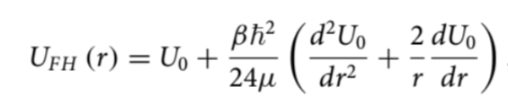
METHODOLOGY
Comparison of Quantum and Classical fields: Quantum has a shallower well and Rmin is shifted rightwards
Change epsilon and sigma parameters to approximately match Feynman-Hibbs potential graph
Inspiration from literature for corrections in epsilon and sigma
Lennard Jones Potential Function
Feynman–Hibbs effective
quantum potential

Slide 5
METHODOLOGY
Observed that graph has correct minima position, but the well is too deep
Used a (1+α) factor to account for the extra depth
Initially, α obtained analytically from the equations
But, observed that numerical methods do a much better job
Alpha found using minimization of area between r = σ and r = 1.5 σ
Values validated using Energy Minima of new graph and quantum graph

Slide 6
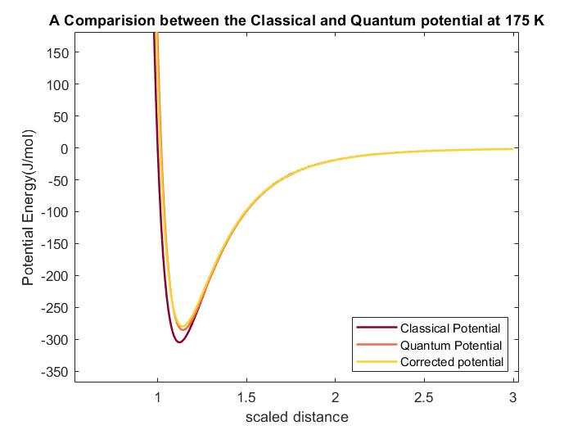
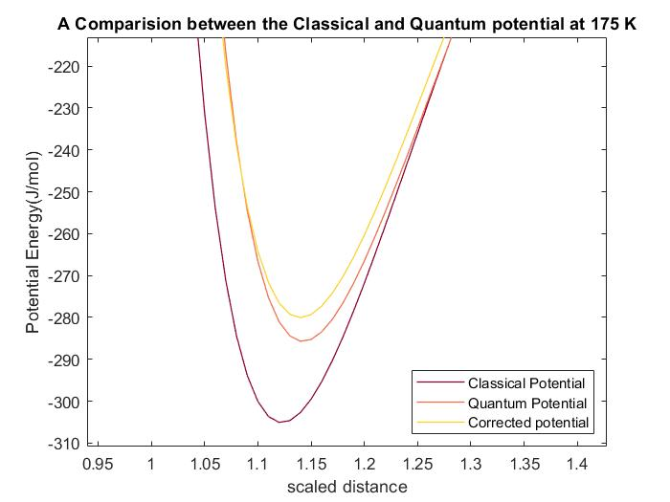
RESULTS

Slide 7
CONCLUSIONS
Through a simplified approach we are able to capture quantum effects in the effective force field
Further scope: Cage occupancy of hydrates structures can be calculated, and effect of quantum model can be determined, useful in practical applications of hydrogen fuel

Slide 8
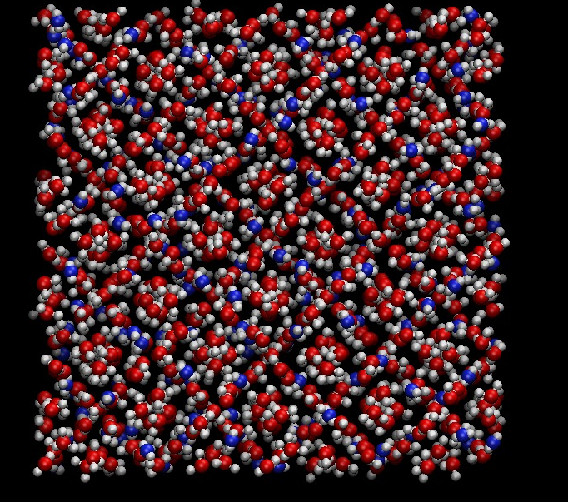
THANK YOU

